Slide 1



Slide 2
AGENDA
What is Tailwind CSS?
Installation
Helpful Extensions
Utility-First Fundamentals
Tailwind Configuration

Slide 3
Tailwind CSS is basically a utility-first CSS framework for rapidly building custom user interfaces.
Tailwind CSS was released in May 2019 by Adam Wathan

Slide 4
Installation
Create Vue Project
$ vue create project-name
To install the dependencies required to work with Tailwind
$ npm install -D tailwindcss@latest postcss@latest autoprefixer@latest
To generate config files
$ npx tailwindcss init -p
Go to the tailwind.config.js file
=> Add this code
purge: ['./index.html', './src/**/*.{vue,js,ts,jsx,tsx}']

Slide 5
Installation (continue)
Go to folder src/assets/ Create tailwind.css, and copy this code below to paste
$ @tailwind base;
$ @tailwind components;
$ @tailwind utilities;
Go to folder src/main.js, and import tailwind.css from folder above
$ import './assets/tailwind.css'
Run the project
Test by adding some style to make sure it work
<h1 class="text-pink-400">Hello, TailwindCSS</h1>

Slide 6

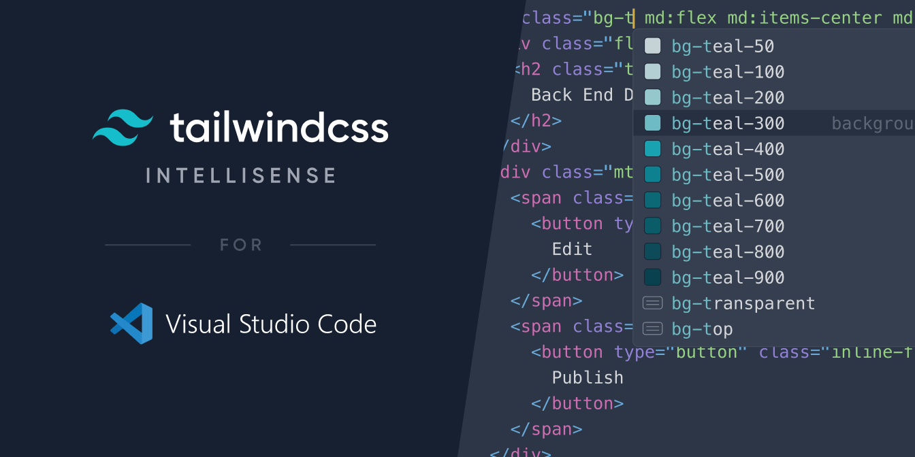
Helpful Extensions VS-Code

Slide 7
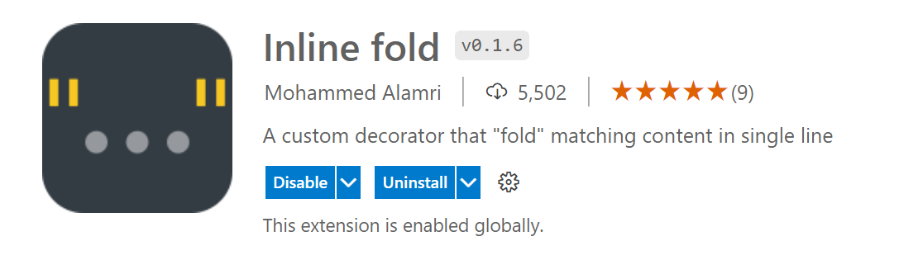
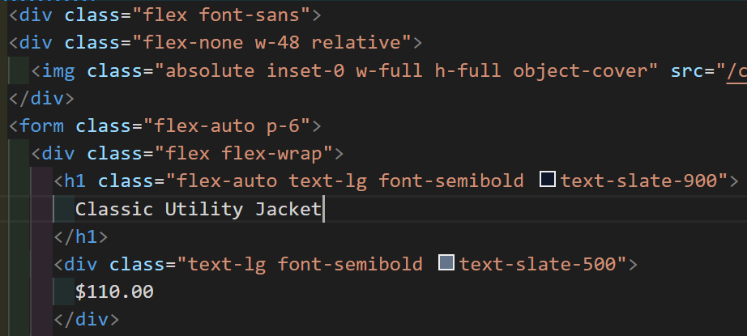
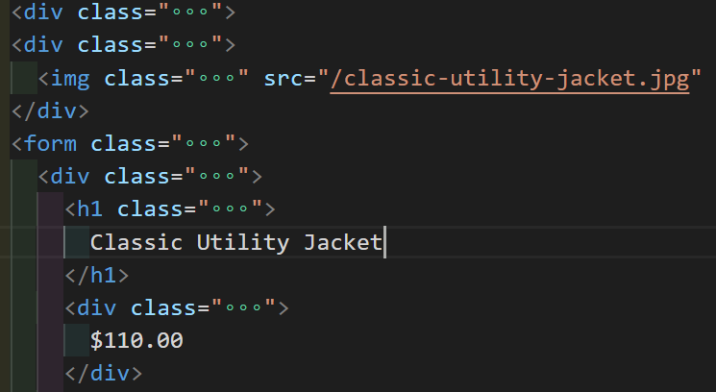
Helpful Extensions VS-Code

Slide 8
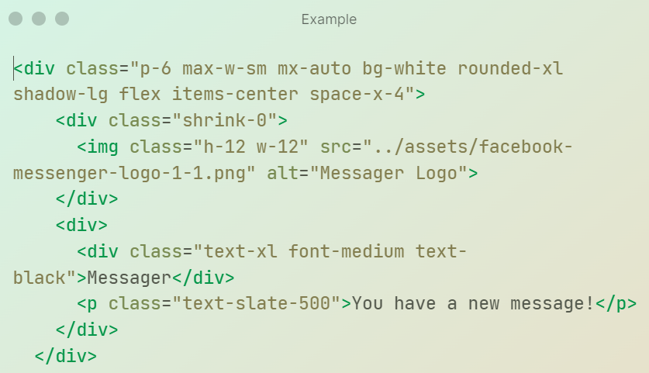
Utility-First Fundamentals
Traditionally, whenever you need to style something on the web, you write CSS, but with Tailwind, you style elements by applying pre-existing classes directly in your HTML.

Slide 9

Utility-First Fundamentals
In the example above, we’ve used:
flexbox and padding utilities to control the overall card layout
max-width and margin utilities to constrain the card width and center it horizontally
background color, border radius, and box-shadow utilities to style the card’s appearance
width and height utilities to size the logo image
space-between utilities to handle the spacing between the logo and the text
font size, text color, and font-weight utilities to style the card text
Learn more: https://tailwindcss.com/docs/utility-first#why-not-just-use-inline-styles

Slide 10
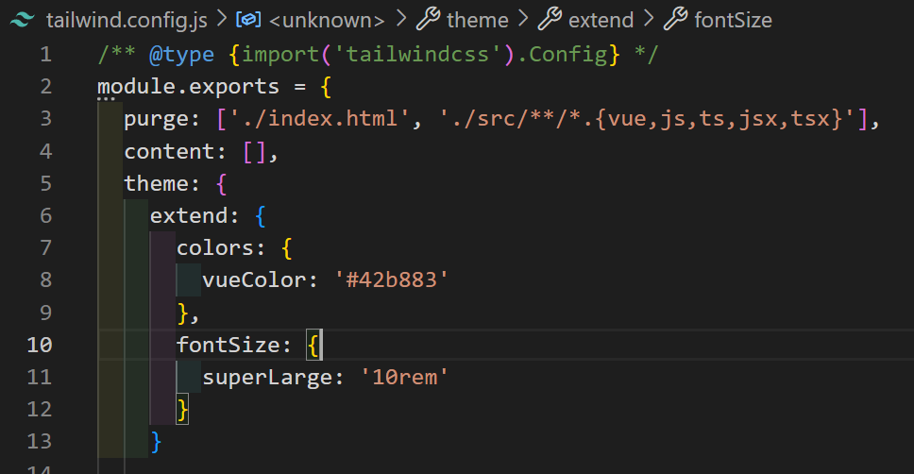
Tailwind Configuration
Go to tailwind.cofig.js
Ex:
Customize whatever you want in extend

Slide 11
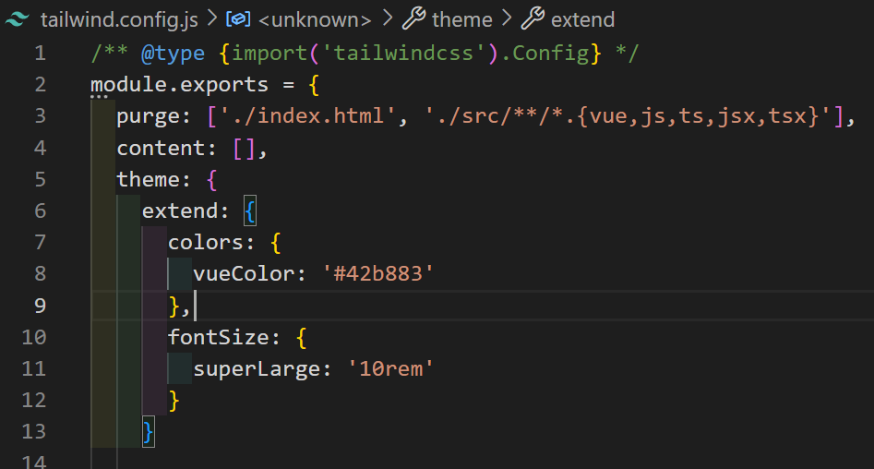
Tailwind Configuration
How to use what we customized
Ex:
<h1 class="text-superLarge">Hello, TailwindCSS</h1>
<h1 class="text-vueColor
">Hello, TailwindCSS</h1>

Slide 12
References
Installation
https://medium.com/featurepreneur/set-up-tailwind-css-for-your-vue-js-app-5a8801fd0a55
Usages
https://tailwindcss.com/docs/using-with-preprocessors

